Slide 1
Opportunities for Autogas in (A)OEM
Luis Fernández
© 2014 Prins Autogassystemen B.V.

Slide 2
Overview
Introduction Prins and some best practices
Definition of (A)OEM / After OEM market
Changing market conditions
Opportunity for autogas
Case: Hyundai Motor Germany (HMD)
Questions

Slide 3

Introduction Prins
Located in Eindhoven, NL active in engineering, development and distribution of alternative fuel systems for more than 25 years. Prins is a group company of SHV Energy
Prins is 3rd largest manufacturer of LPG, CNG and LNG systems in the world
R&D partner of KEIHIN Japan and exclusive worldwide aftermarket distributor of injectors and CNG regulators
In-house product development and test facilities
Export to over 50 countries. Customers include (A)OEMs, Country Importers and Distributors

Slide 4
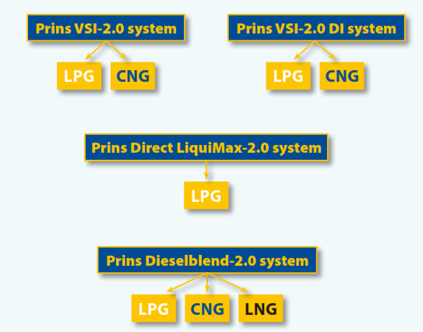
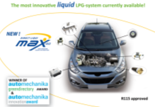
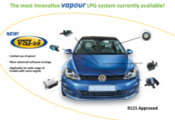
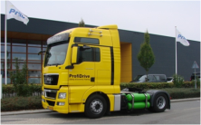
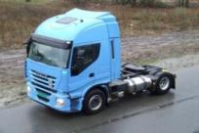
Introduction Prins

Slide 5

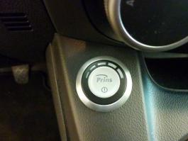


Mazda 2 LPG (100.5 gr/km CO2)
© 2013 Prins Autogassystemen B.V.

Slide 6
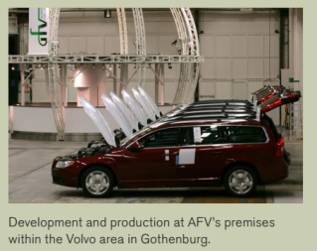

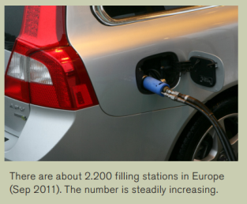
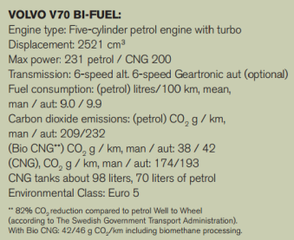
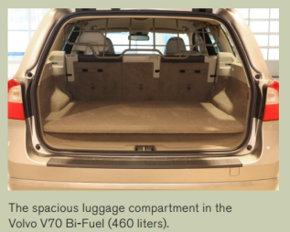

Volvo V70 AFC BI-FUEL by Prins

Slide 7
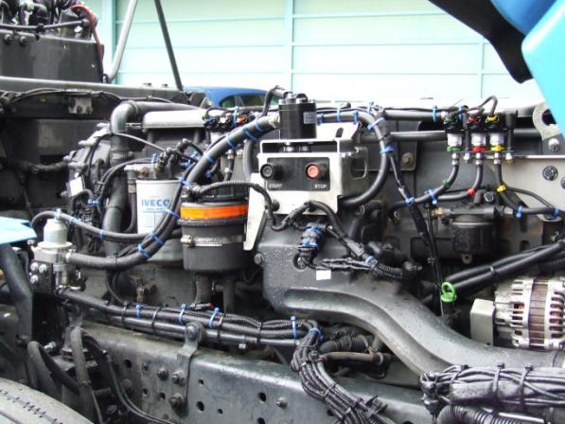

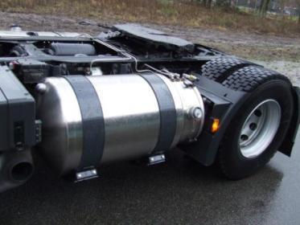
Iveco Stralis LNG
Iveco Stralis

Slide 8
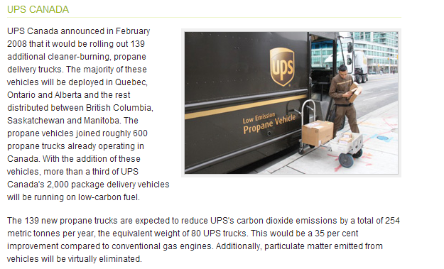
UPS Canada on Prins LPG

Slide 9

Definition (A)OEM
(A)OEM
D-OEM
0 KM conversion to bi-fuel LPG at a PDI centre before shipment to dealer organisation

Slide 10
Changing market conditions
OEMs more and more extend warranty package to pull in clients
CO2 reduction pressure on OEMs lead to engine downsizing, less cylinders, mostly direct injection in combination with small turbo
Direct injection technology requires complex engine specific/dedicated LPG system development
Higher penetration of direct injection engines leads to more dedicated LPG systems and thus less universal systems
When considering LPG consumers have clear demands:
  No extra troubles, maintain factory warranty, leasing and financing options, proper LPG conversion, fast amortization of investment, direct savings on fuel costs and the contribution to a better environment.

Slide 11
Changing market conditions
Bosch sold more than 5 million direct injection systems in 2012. A 50% increase over Y2011. Expected sales in Y2015 more than 9 million DI systems
Source: Bosch Annual Report 2012

Slide 12

Changing market conditions

Slide 13
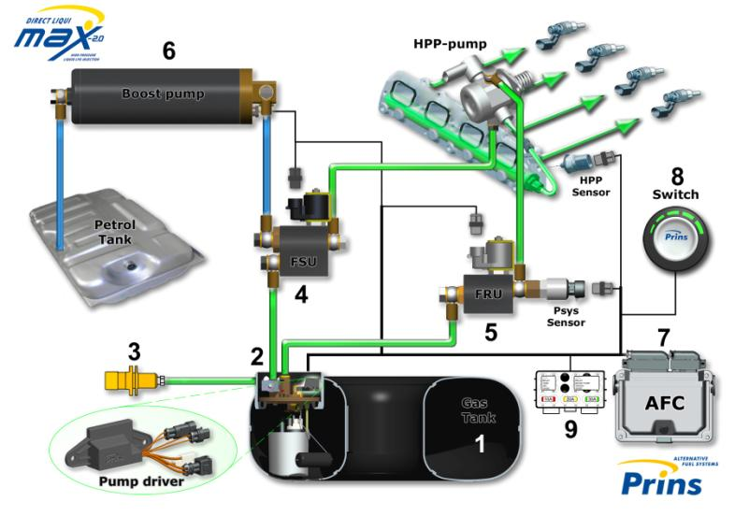
Changing market conditions

Slide 14

Changing market conditions

Slide 15
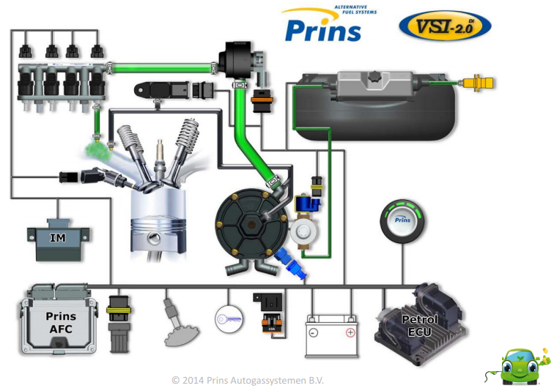
Changing market conditions

Slide 16
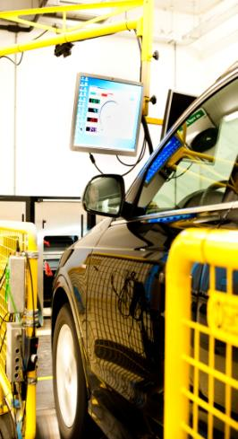
R115 homologations Prins Direct Injection
VAG group ( VW/Audi/Seat/Skoda/Porsche)
GM group (Opel, GM-Holden, Cadillac, GMC)
Hyundai & KIA group
Renault/Nissan/Dacia group
Ford/Volvo/Land Rover/Jaguar group
Mazda group
BMW group
Mercedes group
Fiat/Alfa group
Subaru

Slide 17
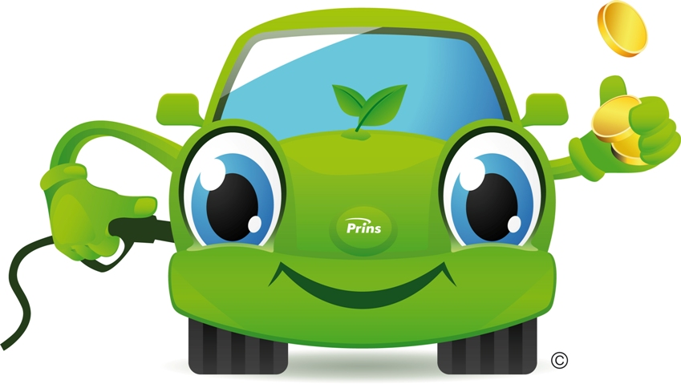
Opportunity for autogas
LPG helps OEM to reduce CO2 levels up to 15%, even of direct injection engines, and reduces emission of particles up to 90%
LPG is the ‘better fuel’ for direct injection based on research done at FVV in Germany (research network engine technology)
Conversion of 0 km vehicles automatically implies a max LPG consumption during vehicle life time
For LPG system manufacturers conversion of single brand, engine and predetermined models spreads costs of dedicated system development – economies of scale
Centralized conversion implies better standardization, higher quality and control with faster installation time
  End customer demands when considering LPG are fulfilled!

Slide 18
Case: Hyundai Motor Germany
Cooperation of Prins together with local partner ecoengines GmbH and Hyundai Motor Germany (HMD)
Delivery program all direct injection GDI models
Prins Direct LiquiMax 2.0 LPG system
Centralized PDI and decentralize conversion
5 years warranty (insurance package)
Leasing and financing options – LPG fleet initiative
Training PDI centers and selected Hyundai Dealers

Slide 19
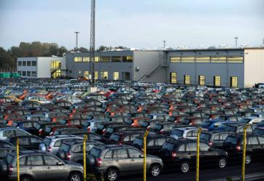
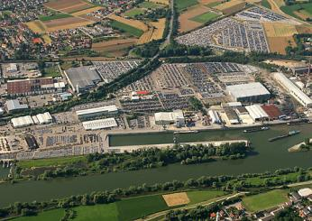
Case: Hyundai Motor Germany
PDI Conversion Centers
BLG Auto Terminal Bremerhaven BLG AutoTerminal Kelheim
centre with parking space for 10,000 vehicles over an area of 300,000 m²
capacity for 26,000 vehicles over an area of 507,000 m². 185 staff

Slide 20




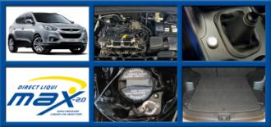


Case: Hyundai Motor Germany
Order
PDI
Hyundai Dealer
Ecoengines GmbH

Slide 21
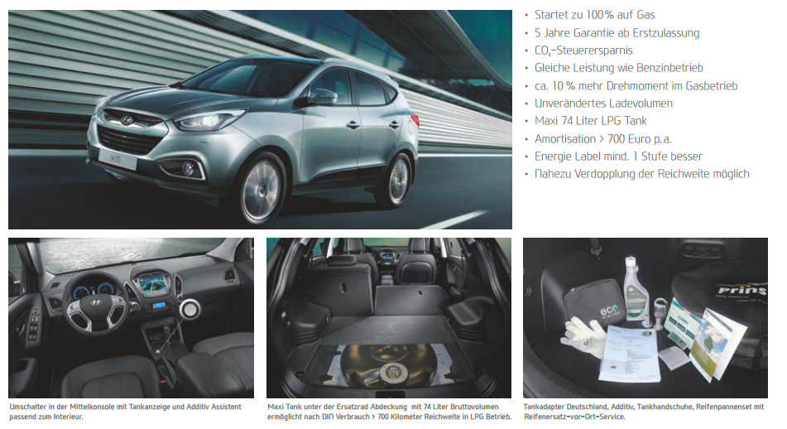
Case: Hyundai Motor Germany

Slide 22
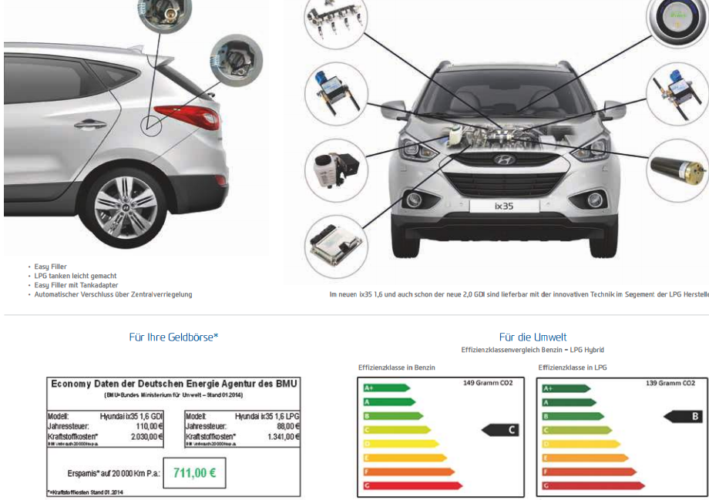
Case: Hyundai Motor Germany

Slide 23

Questions?
Discussion

Slide 24
Thank you
for your attention
More information please contact l.fernandez@prinsautogas.com

